Slide 1
Introduction to Form 8843
Office of international Students & Scholars

Slide 2
Who needs to submit form 8843?
In the U.S. under F1, J-1, F2, or J-2 status
Present in the U.S. during 2024 (1 day or more)
A nonresident alien for tax purposes
Even if you don’t need to file an income tax return, you need to file Form 8843
Notes:
If all three criteria on slide are met, you need to file Form 8843.

Slide 3
Nonresident Alien for tax purposes
F Visa: nonresident alien for tax purposes for first 5 calendar years in U.S.
J Visa: nonresident alien for tax purposes for 2 out of the last 6 calendar years in U.S.

Slide 4
Who is this PRESENTATION for?
People who need to complete only Form 8843 for the 2024 tax season.
If you were:
Present in the U.S. during 2024 (1 day or more)
A nonresident alien for tax purposes
F or J visa status with no taxable income from U.S. sources
Notes:
If you meet all three criteria on slide, you submit only Form 8843.

Slide 5
ANY Taxable income in 2024?
Form 8843 – generated when you file federal taxes
Income from Tulane?
Use Glacier Tax Prep (GTP)
Email from support@online-tax.net on 3/12/25
Income from other U.S. source?
Use Sprintax or VITA
IMPORTANT
CANNOT use TurboTax, Tax Tiger, etc
Only for Resident Aliens for Tax Purposes

Slide 6
Form 8843:
Not an income tax return; just an informational statement
Documents the number of days spent inside the US
Which days can be excluded in determining residency for tax purposes

Slide 7
Tips for completing form 8843:
Students – F1 & J1 Visa Status: Complete Parts I and III
Scholars – J1 Visa Status: Complete Parts I and II
F2 and J2: Complete Part 1 and same section as the primary (Part II or Part III)
Even if you are not required to file a federal tax return, you still must mail a paper Form 8843 to the Internal Revenue Service Center in Austin, TX by April 15, 2025.
Notes:
If you were filing a Federal Tax Return, then Form 8843 would be due April 15, 2025, (submitted with your Federal Tax Return).
If you are only submitting Form 8843, the deadline is also April 15, 2025.

Slide 8
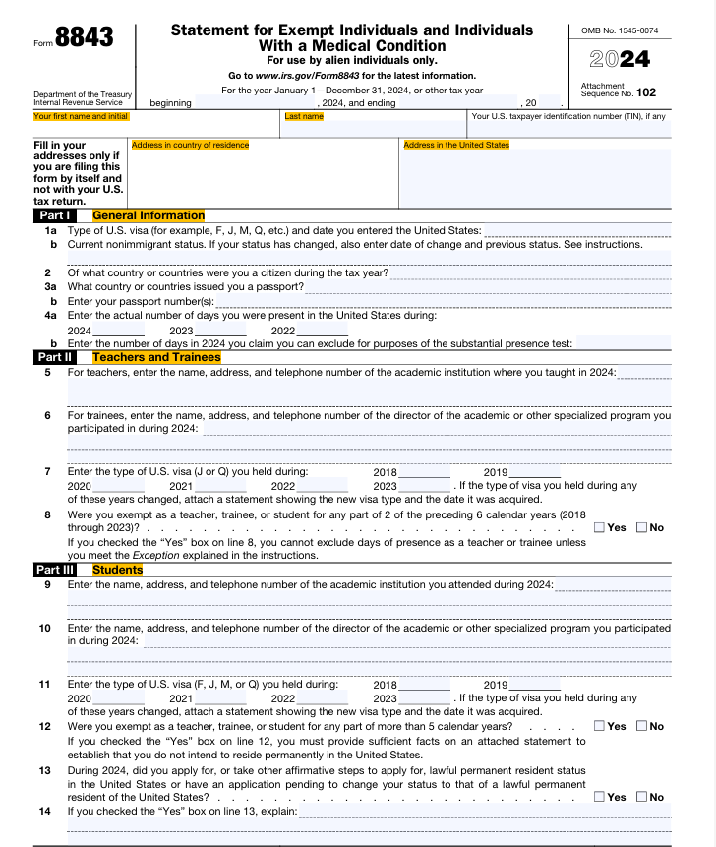
Notes:
You can find Form 8843 and instructions at:
https://www.irs.gov/pub/irs-pdf/f8843.pdf
(Or just search online for “Form 8843”)

Slide 9
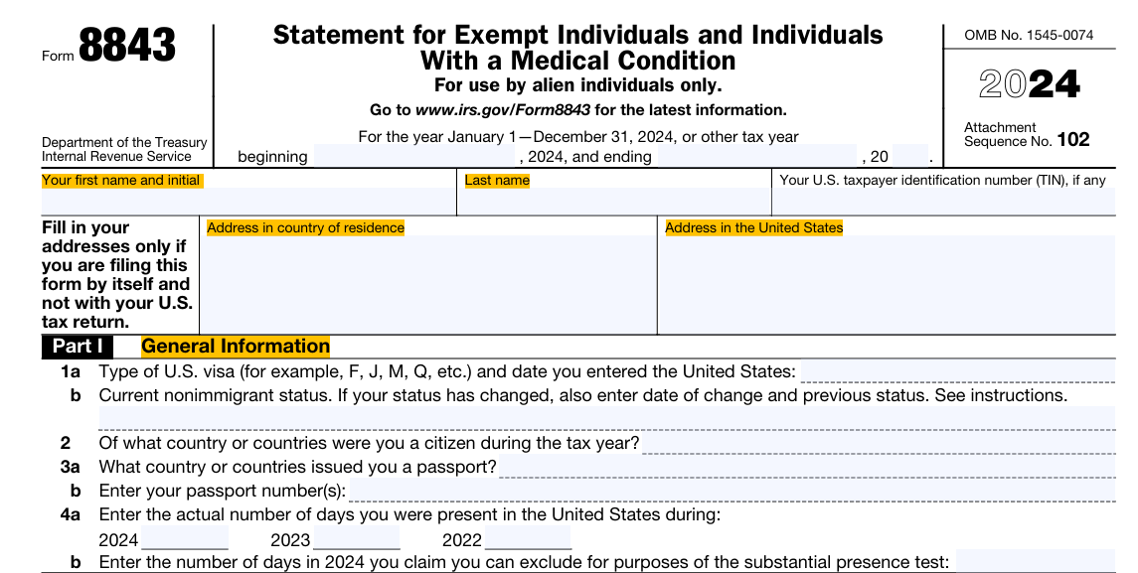
Notes:
-Fill your name the same as it appears on your passport.
-If you have a SSN or TIN, fill it in. If you do not, leave it blank. This is not required if you are filing only Form 8843.
-Use your I-94 history to calculate the actual days you were in the U.S in a given year.
-Line 4b will usually be the same as line 4a.

Slide 10
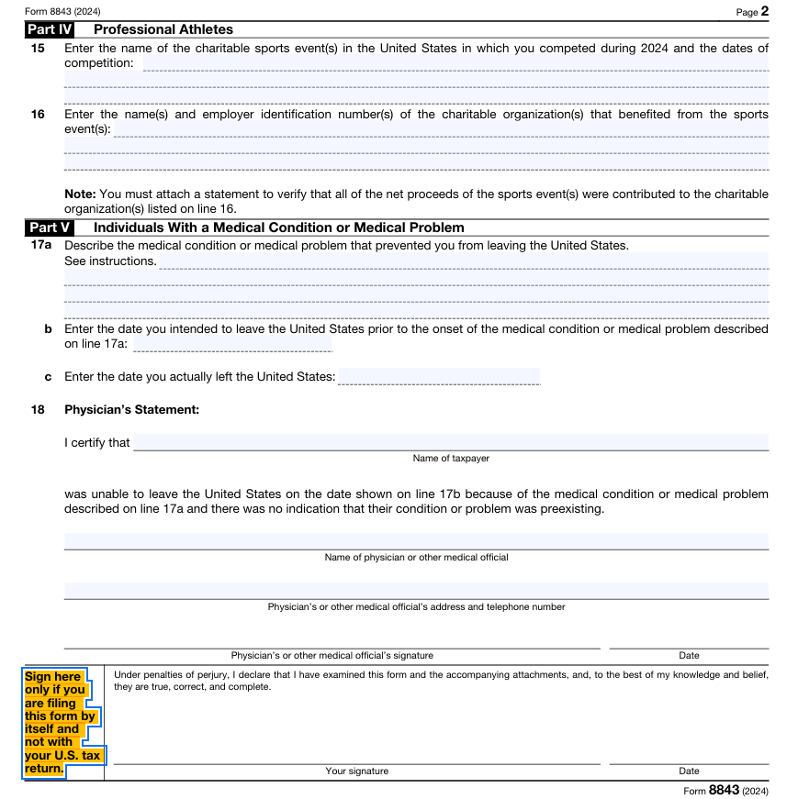
Notes:
Print the form and then sign and date the paper form before mailing it to the IRS.

Slide 11
completing form 8843 for dependents:
Completing Part II or Part III (same Part as primary visa holder):
Spouse (or Dependent) of student attending Tulane University
Use same information as primary visa holder
Form 8843 must be submitted for all dependents including children, regardless of age.
If a child under the age of 14 has to file Form 8843, but can't sign, the child's parent, must sign the child's name, followed by the words "By (your signature), parent for minor child.“
Form 8843 must be sent in a separate envelope for each dependent.

Slide 12
Deadline and mailing information
You can find Form 8843 and instructions at:
https://www.irs.gov/pub/irs-pdf/f8843.pdf
Deadline if filing ONLY Form 8843:
April 15, 2025
Send to:
Department Of the Treasury
Internal Revenue Services Center
Austin, TX 73301-0215
Remember: each Form 8843 must be sent in a separate envelope.
Notes:
Or just search online “Form 8843”

Slide 13
Additional questions?
More information can be found:
IRS Link and Learn Completing Form 8843
OISS Tax Information Webpage

Slide 14
disclaimer
OISS staff are not certified tax experts, therefore we can’t provide specific tax advice. All information provided in this presentation can be found on the IRS website as well as in the instructions for Form 8843.

